Slide 1

Resample-based Ensemble Framework for Drifting Imbalanced Data Streams
By: Jawdat haron

Slide 2
About the paper
This paper was done by HANG ZHANG1 , WEIKE LIU , SHUO WANG , JICHENG SHAN1 , QINGBAO LIU
Was published in 06 May 2019.
Made in China
IEEE paper.
Unfortunately there is no open source implementation for it online.

Slide 3
The aim of the paper
This paper was created to overcome the problem of classification of data streams that have minority classes and have data drifts (sudden or gradual).
It present a solution that overcome the minority class problem.
And overcome the drifting problem.

Slide 4
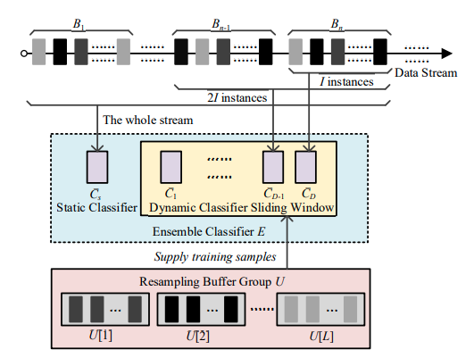
The solution

Slide 5
The solution
Inputs:
1. S: data stream
2. L: number of classes
3. I: size of the data blocks
4. D: number of dynamic classifiers
5. ɛ: instance selection ratio of the classifier initialization.
Output: Ensemble Classifier E

Slide 6
The solution algorithm
Initialization:
1. B: circular cache array, initialized as an empty array
2. U[l]: resampling buffer for storing instances
3. p=0: counter of processed instances
4. i=0: indicator of current position in circular cache array
5. k=0: indicator of the dynamic classifier

Slide 10

Thank You
someone@example.com

